Slide 1
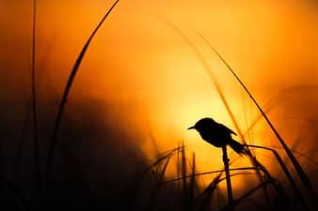
The Power of Being Better
By: Kaiya

Slide 2

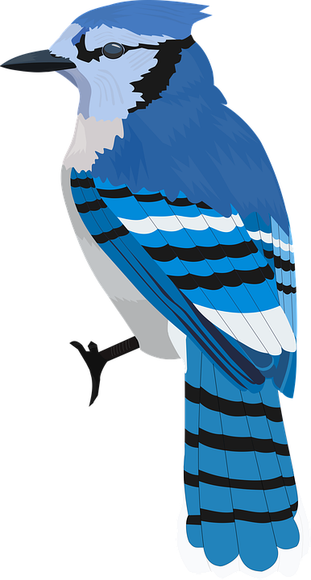
Part One
Once upon a time there lived a community of Blue Jays. In this community there lived two very close sisters. Sunshine and Sky. Sunshine and Sky were the best of siblings and the best of friends. They always had each other’s back and always helped each other. One day Sky’s sister, Sunshine was out on a flying mission and Sky was on her own. She decided to take advantage of this moment.

Slide 3

Sky flew down to the skybridge the Blue Jays had built just one year ago. Many other birds flew and walked below. Sky joined the crowd and marveled at the sky reflected on the glass bridge. As she walked on the bridge she felt something catch her foot and she fell forward. Pushing herself up back onto her feet she looked around. There she saw stood the biggest bully in Blue Jay school. It was BlueBird.

Slide 4
“Look who it is,”
BlueBird was standing triumphantly above her. He loomed over her, a wicked smile on his face.
“Look who it is,” he said. “Little sky, never able to fly. Oh! And It rhymes! Sky, fly.”
“I can fly,” Sky said defiantly.
“Ya ya,” BlueBird said and he kicked Sky again. Sky fell and cowered under BlueBirds gaze. “Little, baby, bird, so tiny and unable to -”
BlueBird stopped mid sentence.

Slide 5

“Don’t ever hurt MY SISTER ever again…”
There stood Sunshine, glaring at BlueBird with an intensity that could have thrown daggers. BlueBird sputtered out some random words that sounded like “Um.. I am not doing anything, just leaving.”
Sky could tell BlueBird was afraid of Sunshine. For what reason, Sky was unsure, maybe it was how brave and unaffected by BlueBird Sunshine acted.
“Don’t ever hurt MY SISTER ever again, and if you do I will come after you,” Sunshine said in a firm voice.
This time BlueBird was cowering under Sunshine’s gaze.
“Y-y-yes,” BlueBird said, and then he flew off.
“And don’t bully anyone else,” Sunshine called as he left.

Slide 6
Sunshine looked at her sister.
“You all right?” she asked.
Sky nodded and smiled at Sunshine.
“Thanks.”
Sunshine smiled back. “No problem Sister. I got your back!”

Slide 7

Part Two
BlueBird was the bully and he knew it. It was either him, the bully or him bullied by other, bigger birds. After BlueBird had bullied Sky on the skybridge and after Sunshine had come to Sky’s rescue, BlueBird had gone to his grandfather's place. He always went to his grandfather’s when he was bored and with Sky gone he had no one to bully. BlueBird reached his grandfather’s house in no time at all. He was a fast flier after all. BlueBird knocked and entered the house.

Slide 8
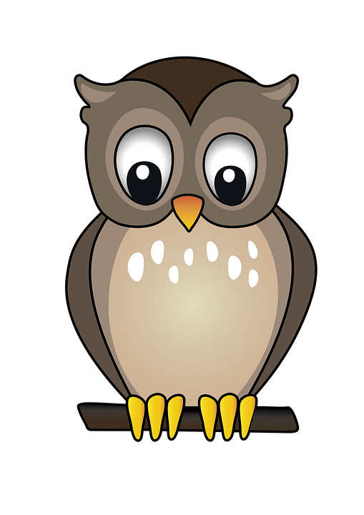

His grandfather was sitting by a miny fireplace drinking a bird version of coffee. His grandfather was also an owl and the wisest birds of all.
“BlueBird,” he said in a rumbling voice, when BlueBird flew in. “What brings you here today?”
“Just bored. Wanted to hang out.”
His grandfather raised a bushy eyebrow. “Bored because you don’t have Sky bully anymore?”
BlueBirds eyes flew open, wide. “How did you know?”
“Owls hear things and know things. Come here.”
BlueBird flew closer to the owl.

Slide 9
“You know, once I was a bully too.”
“Really?” BlueBird asked. “You don’t seem like a bully to me.”
“Yes. I had to be the bully or else I would be bullied. I assume that is how you feel?”
BlueBird nodded. His grandfather couldn’t have put it in better words.
“I am not a bully now,” the owl said. “You see once my grandfather told me something. In fact it was about right after I had bullied another bird similar to the situation this morning with you and Sky. Here is a question. If you stopped bullying people, what do you think would happen to yourself?”
“Well, I would be bullied instead,” BlueBird answered, as if it were obvious.
“OK… who would you be bullied by?”

Slide 10
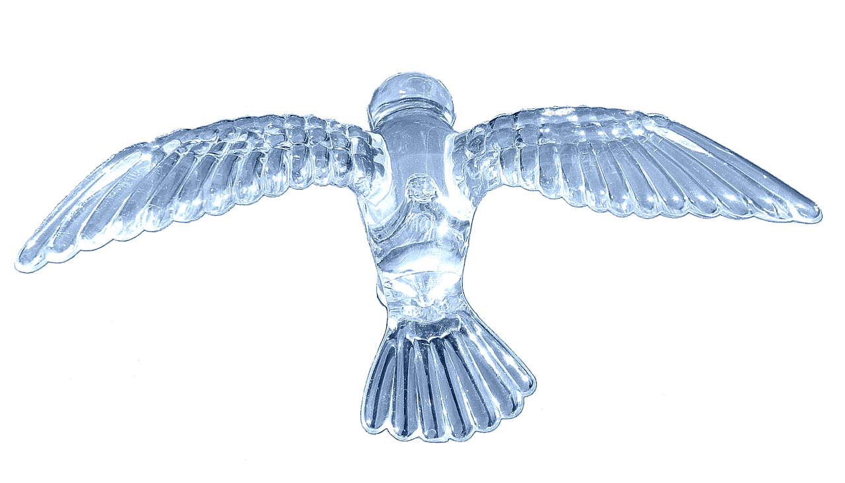
BlueBird thought for a moment. There weren’t that many bullies in the children bird society.
“Probably by the two older birds. GoldenBird and BlackBird.”
“Well then, what if you were Sunshine and reacted to them like Sunshine reacted to you when you were bullying her sister. You will never bully Sky again, so if the older birds bully you and you fight them off, then they will never hurt you again. They might even learn a lesson out of it.”
BlueBird smiled slowly. “You are right. I never thought of it that way.”
His grandfather smiled back. “Try it out and don’t bully anyone.”

Slide 11

BlueBird nodded. He was going to try not to be a bully, and he would try very hard because The Owl asked him to. His grandfather asked and his grandfather was his role model at times.
Ever since then BlueBird never bullied another soul again.

